Slide 1
A PROJECT PRESENTATION ON
“KVM NESTED VIRTUALIZATION USING
ORACLE VIRTUALBOX WITH
CENTOS.”
GUIDED BY: PRESENTED BY:
ZAKIR HUSSIAN RANI BEHARE
GAURI VETAL
SAKSHI SHAHA
DEEPANKER SAMANTHA
HARSHAL PATIL
RENUKA CHAVAN
PRAJWAL NIMKARDE

Slide 2
OUTLINE
Objectives
Introduction
Feasibility Study
A Detailed Walkthrough
Results
Use Cases
Conclusion

Slide 3
OBJECTIVES
Systematically investigate .
Document the process of enabling KVM nested virtualization on Oracle Virtual Box using CentOS.

Slide 4
INTRODUCTION
Nested Virtualization is a feature that allows you to run Hyper-V inside of a Hyper-V virtual machine (VM). Nested Virtualization is helpful for running a Visual Studio phone emulator in a virtual machine, or testing configurations that ordinarily require several hosts.
KVM or (Kernel-based Virtual Machine) is a full virtualization solution for Linux on Intel 64 and AMD 64 hardware that is included in the mainline Linux kernel since 2.6.20 and is stable and fast for most workloads.

Slide 5
KVM Features:
There are many useful features and advantages which you will gain when you use KVM to deploy your virtual platform. KVM hypervisor supports following features:
Over-committing : Which means allocating more virtualized CPUs or memory than the available resources on the system.
Thin provisioning : Which allows the allocation of flexible storage and optimizes the available space for every guest virtual machine.
Disk I/O throttling : Provides the ability to set a limit on disk I/O requests sent from virtual machines to the host machine.
Automatic NUMA balancing : Improves the performance of applications running on NUMA hardware systems.
Virtual CPU hot add capability : Provides the ability to increase processing power as needed on running virtual machines, without downtime.

Slide 6
FEASIBILITY STUDY
HARDWARE REQUIREMENTS:
Operating System: Windows
PROCESSOR: INTEL I5 AND ABOVE
Ram: 8GB And Above
Virtualization: Enables Through Bios
SOFTWARE REQUIREMENTS:
Oracle: Virtualbox
Virtualization Manager
Centos And Mintos

Slide 7
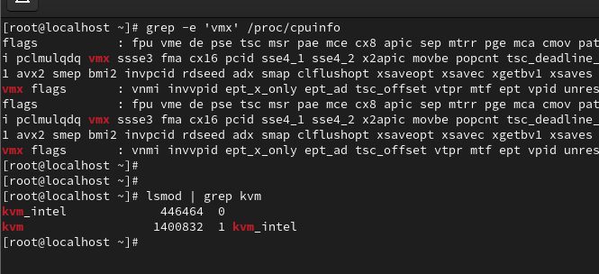
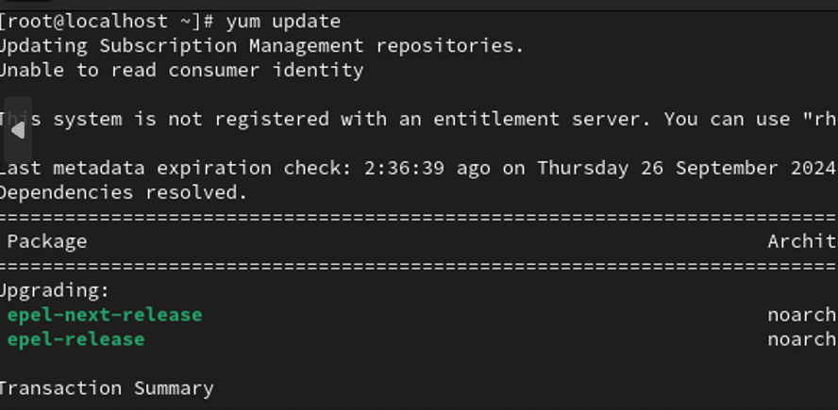
A DETAILED WALKTHROUGH:

Slide 8
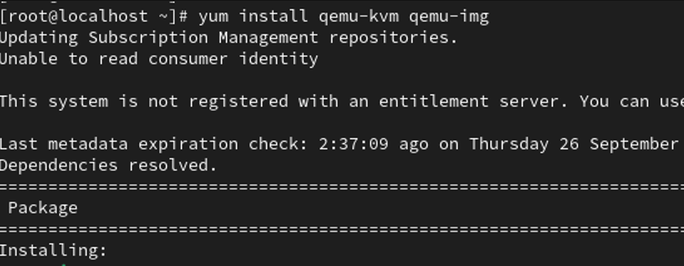
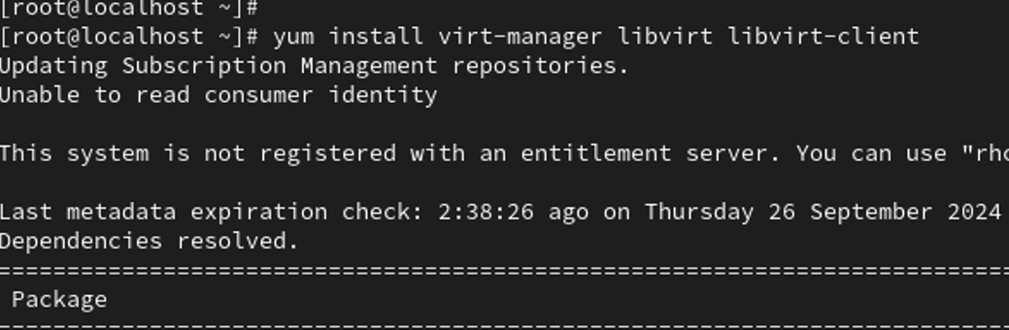

Slide 9
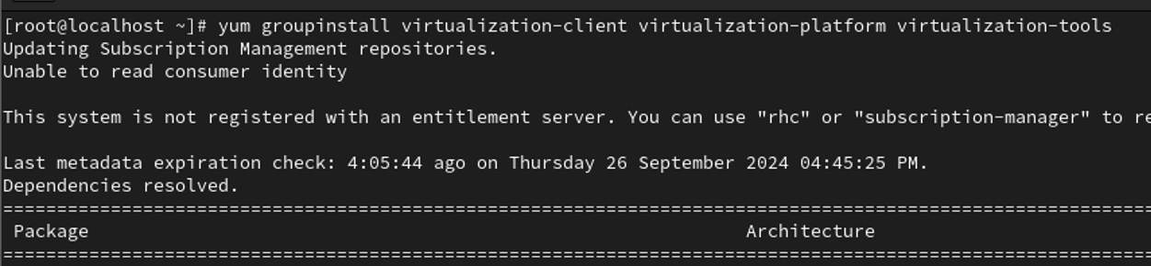
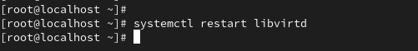

Slide 10
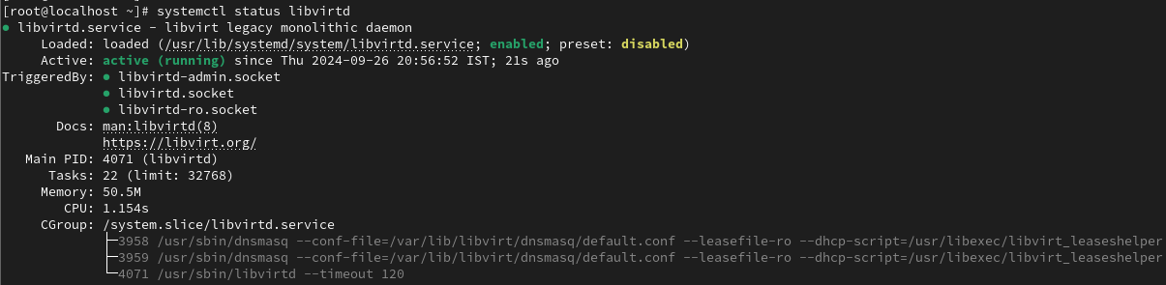

Slide 11
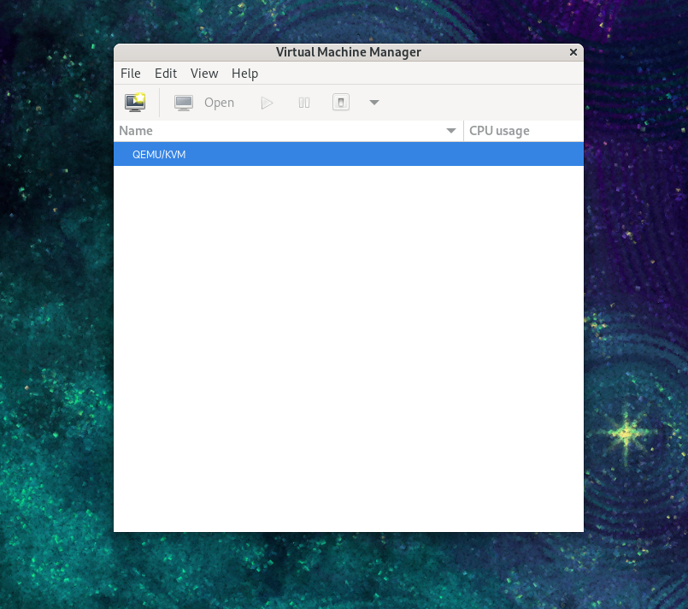
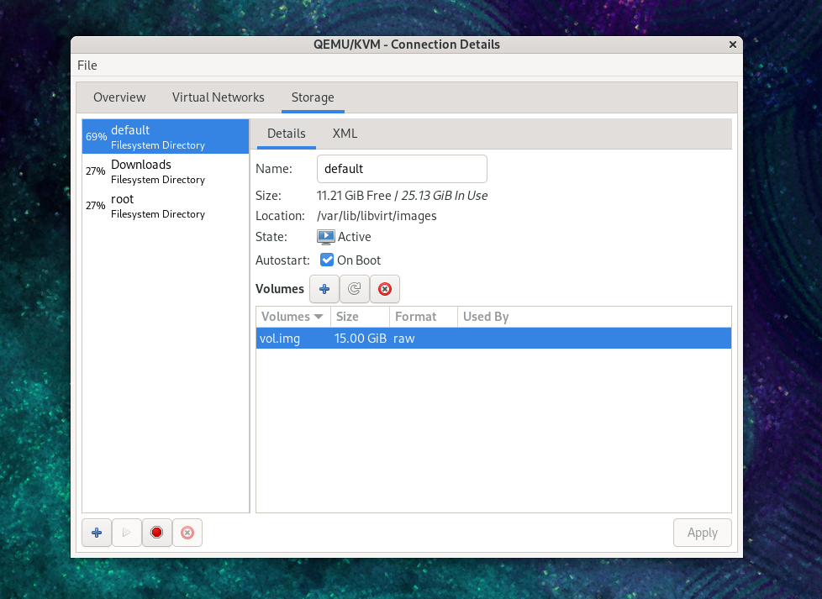

Slide 12
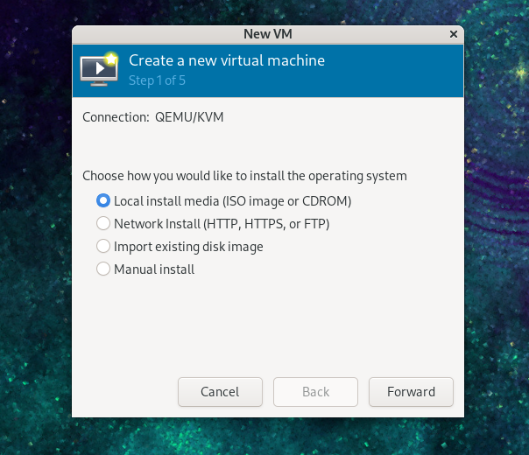
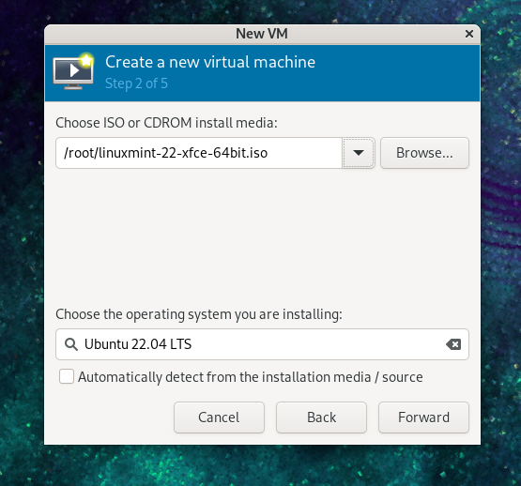

Slide 13
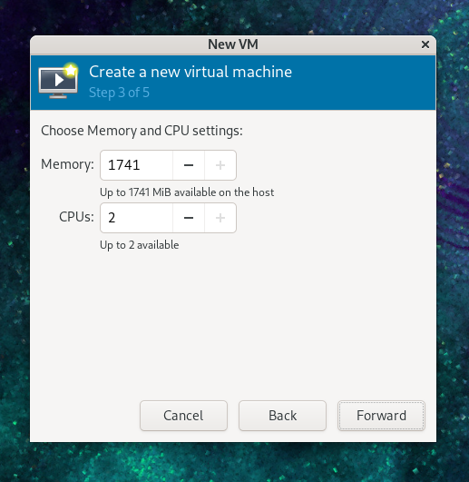
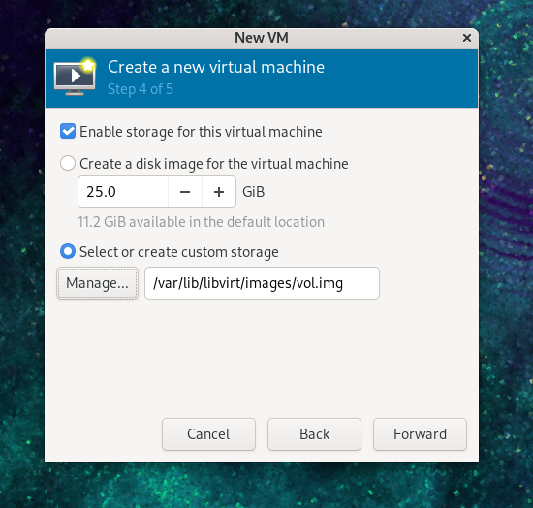

Slide 14
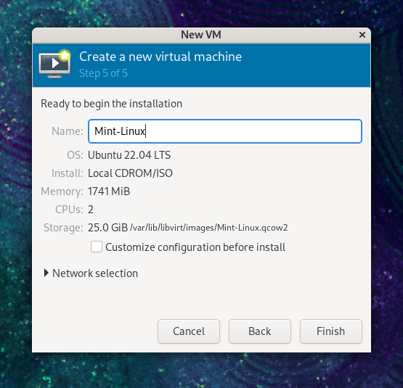
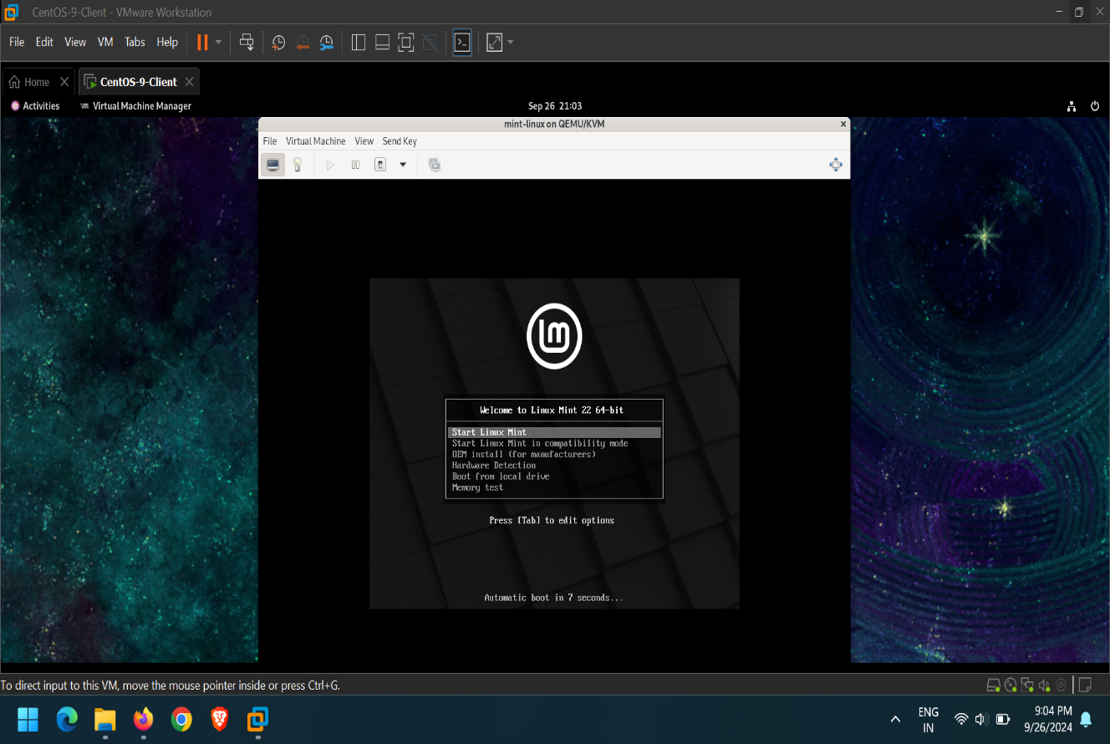

Slide 15
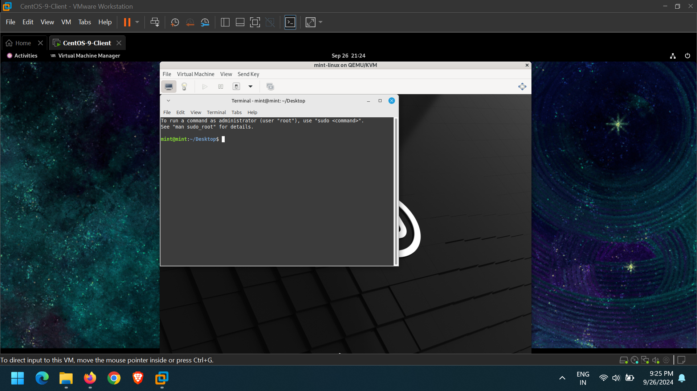
RESULTS:

Slide 16
USE CASES
In a cybersecurity, students could learn how to deploy VMs within other VMs to simulate real-world penetration testing environments.
A company testing its disaster recovery solution might use nested virtualization to spin up backup instances of critical VMs on a cloud platform without affecting the production environment.
A company might use nested virtualization to test different hypervisors (like KVM, VMware ESXi) or create complex environments with multiple layers of virtual machines for development and quality assurance.

Slide 17
CONCLUSION
The project successfully demonstrates the implementation of nested virtualization using Oracle VirtualBox and KVM on a CentOS guest machine.
By enabling nested virtualization, we were able to run a hypervisor (KVM) within a VirtualBox VM, and subsequently create and manage virtual machines inside this nested environment.
This setup provides a powerful framework for testing and experimenting with multi-layered virtualization environments, particularly for development, testing, and educational purposes.

